Slide 1

RUNGTA COLLEGE OF DENTAL SCIENCES & RESEARCH
CHEILOSCOPY & RUGOSCOPY
Dr. Fatima Khan
ORAL MEDICINE, DIAGNOSIS & RADIOLOGY

Slide 2
CONTENTS
CHIELOSCOPY DEFINATION
CLASSIFICATION
RUGOSCOPY INTRODUCTION
CLASSIFICATION BY LYSELL’S
BY BASAURI
BY LIME
BY TROBO
APPLIED ASPECTS
CONCLUSION

Slide 3
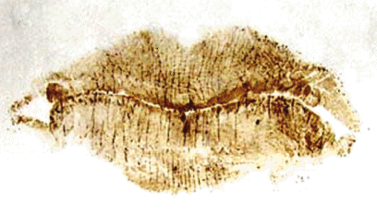
CHEILOSCOPY
Lip prints are normal lines and fissures in the form of wrinkles and grooves present in the zone of transition of human lip, between the inner labial mucosa & outer skin, examination of which is known as Cheiloscopy.

Slide 4
Specific learning Objective
CORE AREAS | DOMAIN | CATEGORY
CHIELOSCOPY DEFINATION | AFFECTIVE | DESIRE TO KNOW
CLASSIFICATION | PSYCOMOTAR | MUST KNOW
RUGOSCOPY INTRODUCTION | COGNITIVE | MUST KNOW
CLASSIFICATION BY LYSELL’S | COGNITIVE | MUST TO KNOW
BY BASAURI | COGNITIVE | MUST KNOW
BY LIME | PYSCOMOTAR | MUST KNOW
BY TROBO | PYSCOMOTAR | NICE TO KNOW
APPLIED ASPECTS | AFFECTIVE | DESIRE TO KNOW

Slide 5



Classification of lip prints
Type I
Type II
Type III

Slide 6


Type IV
Type V
Other Pattern
Type VI

Slide 7
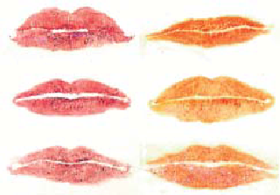

Slide 8
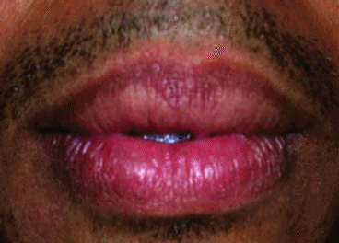
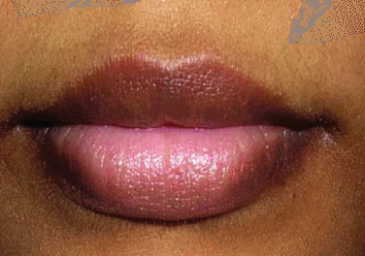
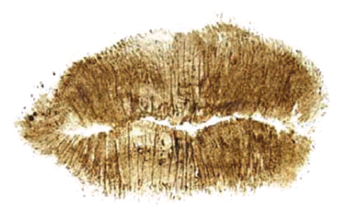
Cheiloscopy for sex determination
Type III (51.05%) lip pattern was predominantly reported in males whereas Type II (37.06%) lip pattern was commonly found in females

Slide 9
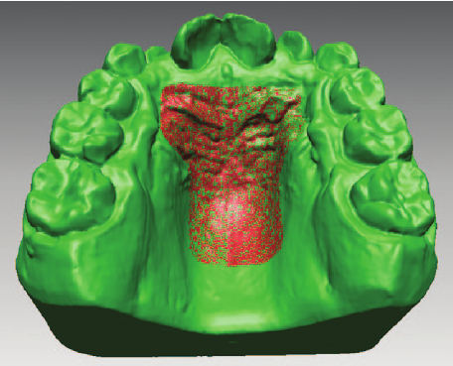
RUGOSCOPY

Slide 10
THE PALATAL RUGAE IN IDENTIFICATION
[RUGOSCOPY]
ACCORDING TO THE GLOSSARY OF PROSTHODONTIC TERMS:
Rugae are anatomical folds or wrinkles (usually used in the plural sense); the irregular fibrous connective tissue located on the anterior third of the palate.
They are also called “plica palatinae” or “rugae palatine”.
Palatoscopy or palatal rugoscopy is the name given to the study of palatal rugae in order to establish a person’s identity.

Slide 11
Palatal rugae appear towards the third month of intrauterine life & its development and growth is controlled by epithelial- mesenchymal interactions.
The first rugae are distinguished in human embryos of 32 mm next to the incisive papilla and in the prenatal stage are relatively prominent.
The palatal rugae at birth are well trained with a typical orientation pattern and adolescence acquires the final feature shape of each individual.
Once they are formed thus, may experience changes in their size due to growth of the palate, but its shape is maintained.

Slide 12
HISTORICAL REVIEW
The earliest reference to rugae was in anatomy textbook y Winslow in 1732 and was first illustrated by Santorin in 1975.
Harrison Allen in 1889 suggested that palatine rugae can be used as an alternative method for human identification.
Palatal Rugoscopy was first proposed in 1932, by a Spanish investigator called Trobo Hermosa.
In 1937, Carrea developed a detailed study and established a way to classify palatal rugae

Slide 13
In 1983, Brinon, following the studies of Carrea, divided palatal rugae into two groups (fundamental and specific) in a similar way to that with the fingerprint.
In this manner, dactiloscopy and palatoscopy were united as similar methods based on the same scientific principles as sometimes, palatoscopy can be of special interest in cases where there are no fingers to be studied

Slide 14
CLASSIFICATION OF RUGAE…
The first system of classification was developed by Goria in 1911 and was rudimentary.
He categorized rugae pattern in two ways:
specifying the number of rugae
specifying the extent of the rugal zone relative to the teeth.

Slide 15
Lysell’s classification in 1955 is the most important, and has been used widely in research involving rugae.
It is comprehensive and includes the incisive papillae.
Rugae are measured in a straight line between the origin and termination and are grouped into three categories:
Primary: 5 millimeters or more;
Secondary: 3 to 5 mm;
Fragmentary: 2 to 3 mm;
Rugae smaller than 2 mm are disregarded.

Slide 16
Thomas & Kotze Classification :
1. Branched
2. Unified
3. Cross linked
4. Annular and
5. Papillary
In 1955, Carrea categorized four main types of rugae according to direction, giving roman numerals, with sequence according to Arabic numerals and the shape denoted by letters

Slide 17
The classification of rugae by Basauri consists of two groups: simple and compound, which is subdivided into 10 types that describe particular shapes:
0: pointed
1: straight
2: curved
3: angled
4: sinuous
5: circular
6: Greek
7: calyx shaped
8: racket-shaped
9: branched

Slide 18
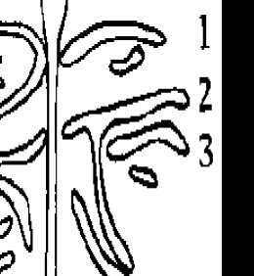
The classification by Lima consists of four main types:
punctuate
straight
curved
composite
Punctate
Straight
Curved
4
Composite

Slide 19
Rugae length was recorded under magnification with a slide calliper to an accuracy of 0.05 mm following the descriptions of Thomas and Kotze.
Having determined the length of all the rugae three categories were formed:
Primary rugae: (A-5 to 10 mm; B-10 mm or more)
Secondary rugae: 3-5 mm
Fragmentary rugae: less than 3 mm. (All rugae more than 1 mm long were recorded under th fragmentary ruga category)

Slide 20
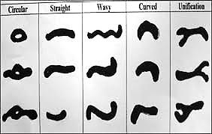
The shapes of individual rugae were classified into four major types:
curved
wavy
straight
circular
FIG 2: RUGAE SHAPES

Slide 21
DIFFERENT PATTERNS OF RUGAE
Curved
Wavy
Straight
Circular

Slide 22
Straight types ran directly from their origin to termination.
The curved type had a simple crescent shape which curved gently.
The basic shape of the wavy rugae was serpentine; however, if there was a slight curve at the origin or termination of a curved rugae it was classified as wavy.
To be classified as circular, rugae needed to display a definite continuous ring formation.

Slide 23
Unification occurs when two rugae are joined at their origin or termination.
Unifications in which two rugae began from the same origin but immediately diverged were classified as diverging.
Rugae with different origins which joined on their lateral portions were classified as converging.

Slide 24
Trobo Classified Palatal Rugae According To Shape, Number, Size And Position
Shape Analysis: The shape of the palatine rugae was registered according to the classification of Trobo.
This classification also divides rugae into two groups: Simple rugae, classified as ABCDEF, where rugae shapes are well defined, and Composed rugae, classified as type X, with a polymorphisms variety (these rugae composed result of the union of two or more simple rugae).

Slide 25
Then he made a rugograma, from the right side and then the left side, starting with the main ruga (closest to the palatal raphe), which was classified with a capital letter, and then rugae were classified with lower case letters. (Fig 3)

Slide 26
Number analysis: There were all palatal rugae that were totally bounded in calcorrugoscopy.
Size analysis: Using a digital caliper (0.01mm) found the maximum longitudinal diameter of all palatal rugae accounted, according to the corresponding type under the classification of shape.

Slide 27
Position analysis: To analyze the position of the palatal rugae were standardized photographs of models obtained and using Photoshop software (Adobe ® Photoshop ® CS4) palate was divided into quadrants, with the aim of obtaining the coordinates position of palatal rugae; for this, six horizontal lines:
I. Transverse line passing through the palatal cervical third of the central incisors.
II. Transversal line that goes from the mesial side of the right lateral incisor to the mesial side of the left lateral incisor.
III. Transverse line through the mesial side of the right canine and reaches to the mesial side of the left canine.

Slide 28
IV. Transverse line through the mesial side of the right first premolar and reaching to the mesial side of the left first premolar.
V. Transverse line through the mesial side of the right second premolar and reaching to the mesial side of the left second premolar.
VI. Transverse line through the distal side of the second premolar and reaching to the right side of the distal left second premolar.

Slide 29
Based on these lines between the areas they were named as follows:
Between lines I and II.
Between lines II and III.
Between lines III and IV.
Between lines IV and V.
Between lines V and VI.

Slide 30
Applied aspects of Rugoscopy:
Useful in investigation of trauma such as loss of tooth, persistent pressure, extreme finger sucking, orthodontic tooth movement
Antemortem and postmortem identification
To analyze inter-racial differences
Personal identification
Age and sex determination

Slide 31
CONCLUSION
Palatine rugae can be used to assess the amount of anteroposterior tooth movement, because they remain stable during a person’s life.
Located in the anterior half of the roof of the mouth, palatal rugae serve as a reference landmark in various dental treatment modalities and could be used in the identification of submucosal clefts.
Moreover, the results of several studies show a significant association between rugae forms and different races.
Palatine rugae are unique to individual can therefore be used for individual identification in forensic odontology.

Slide 32
Probable Question
Types of Chieloscopy
Rugoscopy
Types of Rugoscopy

Slide 33
REFERENCES:
Shafer’s Textbook of Oral Pathology 7th edition
Lessig R, Wenzel V, Weber M. Bite mark analysis in forensic routine case work . EXCLI Journal 2006;5:93
Iain A Pretty. Forensic dentistry & Bitemarks. Dental update 2008.
A colour atlas of forensic dentistry – Whittaker and MacDonald

Slide 34
Text book of forensic Odontology – KMK Masthan
Shafer’s textbook of oral pathology - 6th edition
Text book of forensic Odontology – Pramod K Dayal

